Slide 1
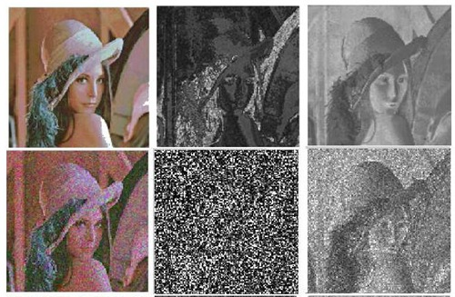
Image processing
Yoni Chechik
www.AIisMath.com

Slide 2
References
http://szeliski.org/Book/
http://www.cs.cornell.edu/courses/cs5670/2019sp/lectures/lectures.html
http://www.cs.cmu.edu/~16385/

Slide 3

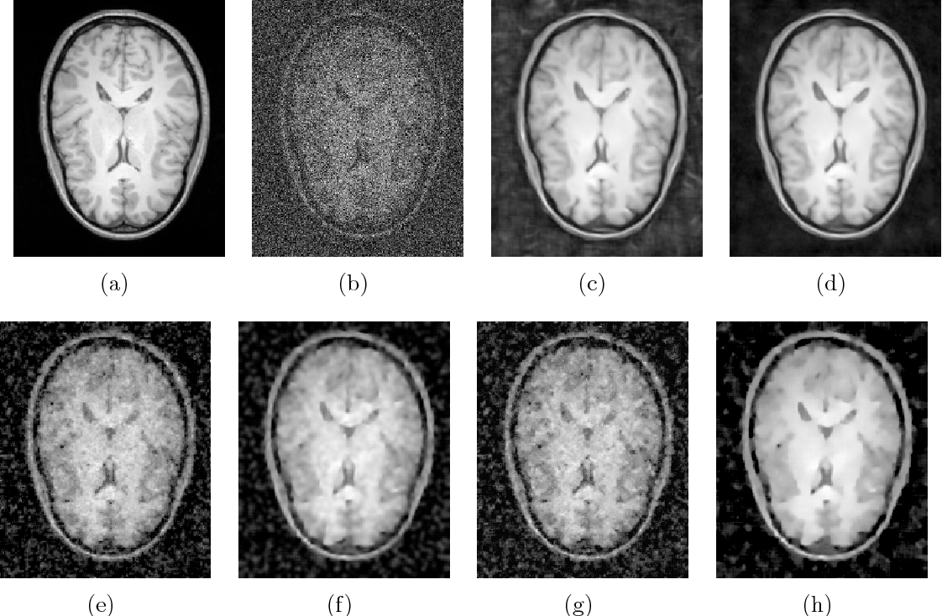
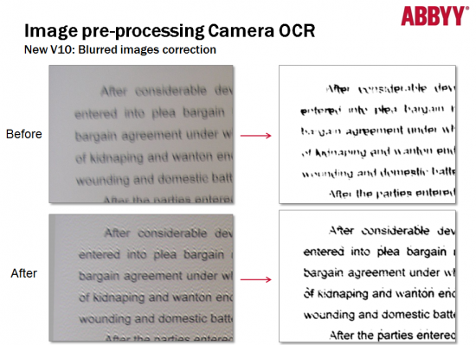
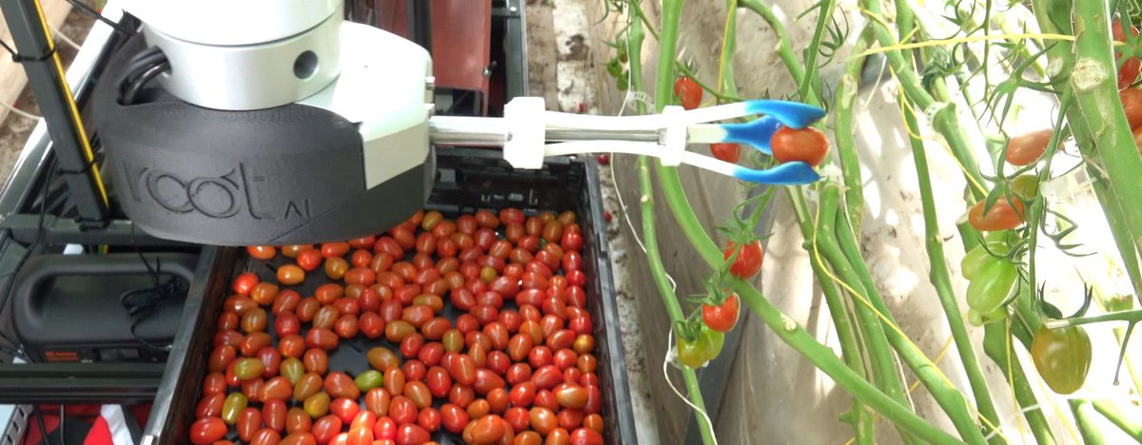
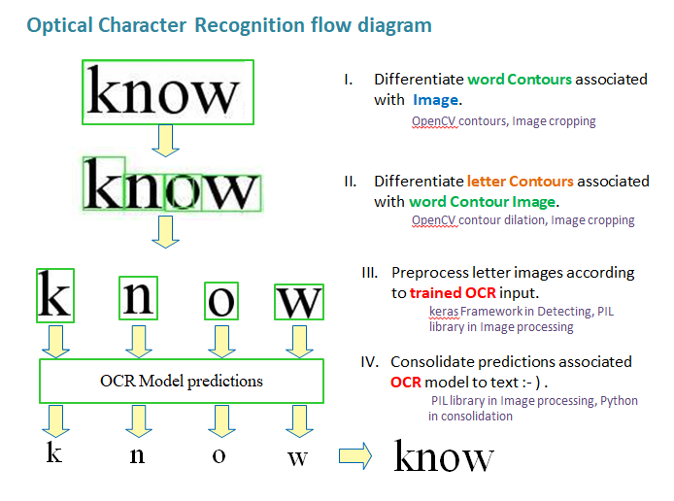
Some motivation
Art
(Photoshop image correction)
Medicine
(MRI denoising)
Robotics
(OCR – optical character recognition)
Agriculture
(color ripeness detection)

Slide 4
contents
Image representation
Pixel-wise operations
Noise and filtering
Frequency representation
Decimation
Interpolation
Morphology operators
Connected components

Slide 5
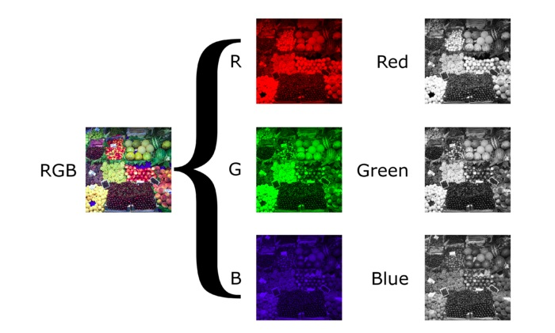
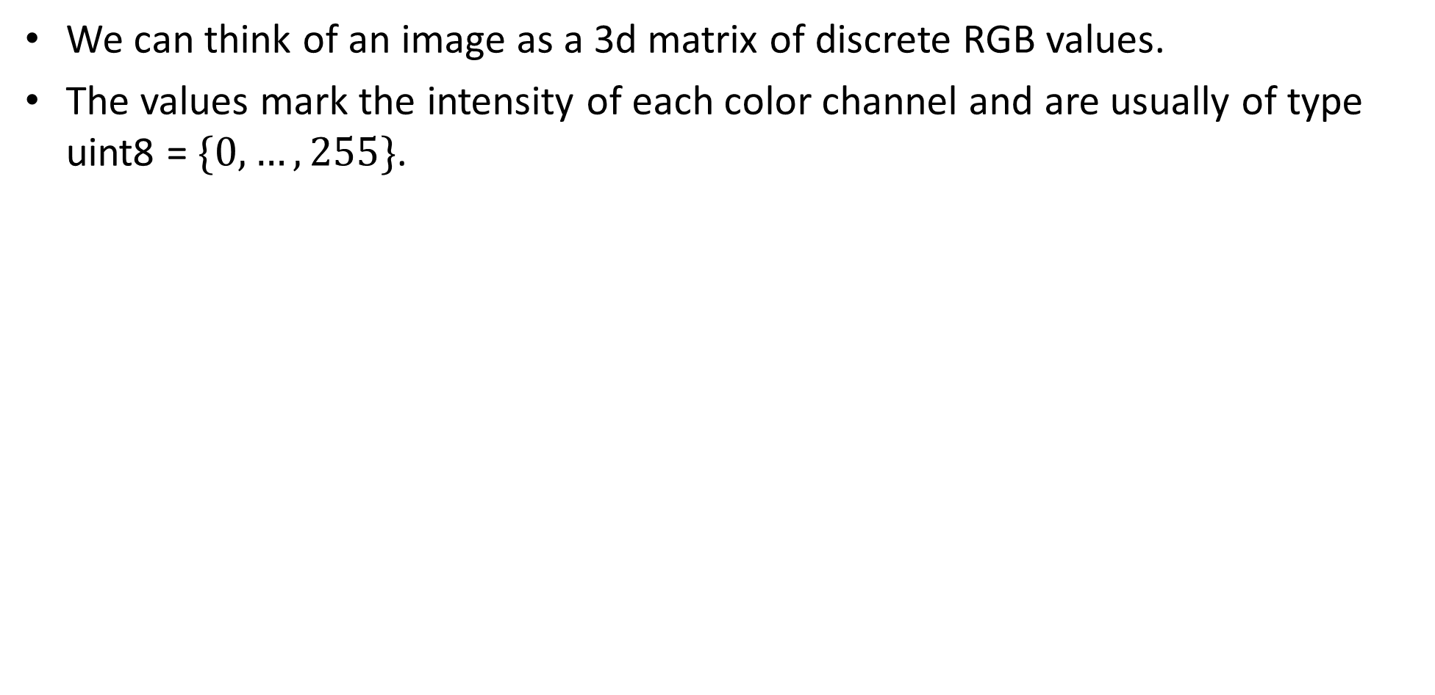
Image representation
We can think of an image as a 3d matrix of discrete RGB values.
The values mark the intensity of each color channel and are usually of type uint8 =$\{0,…,255\}$.

Slide 6
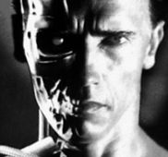
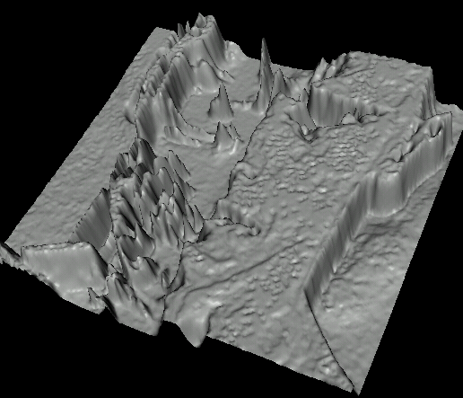
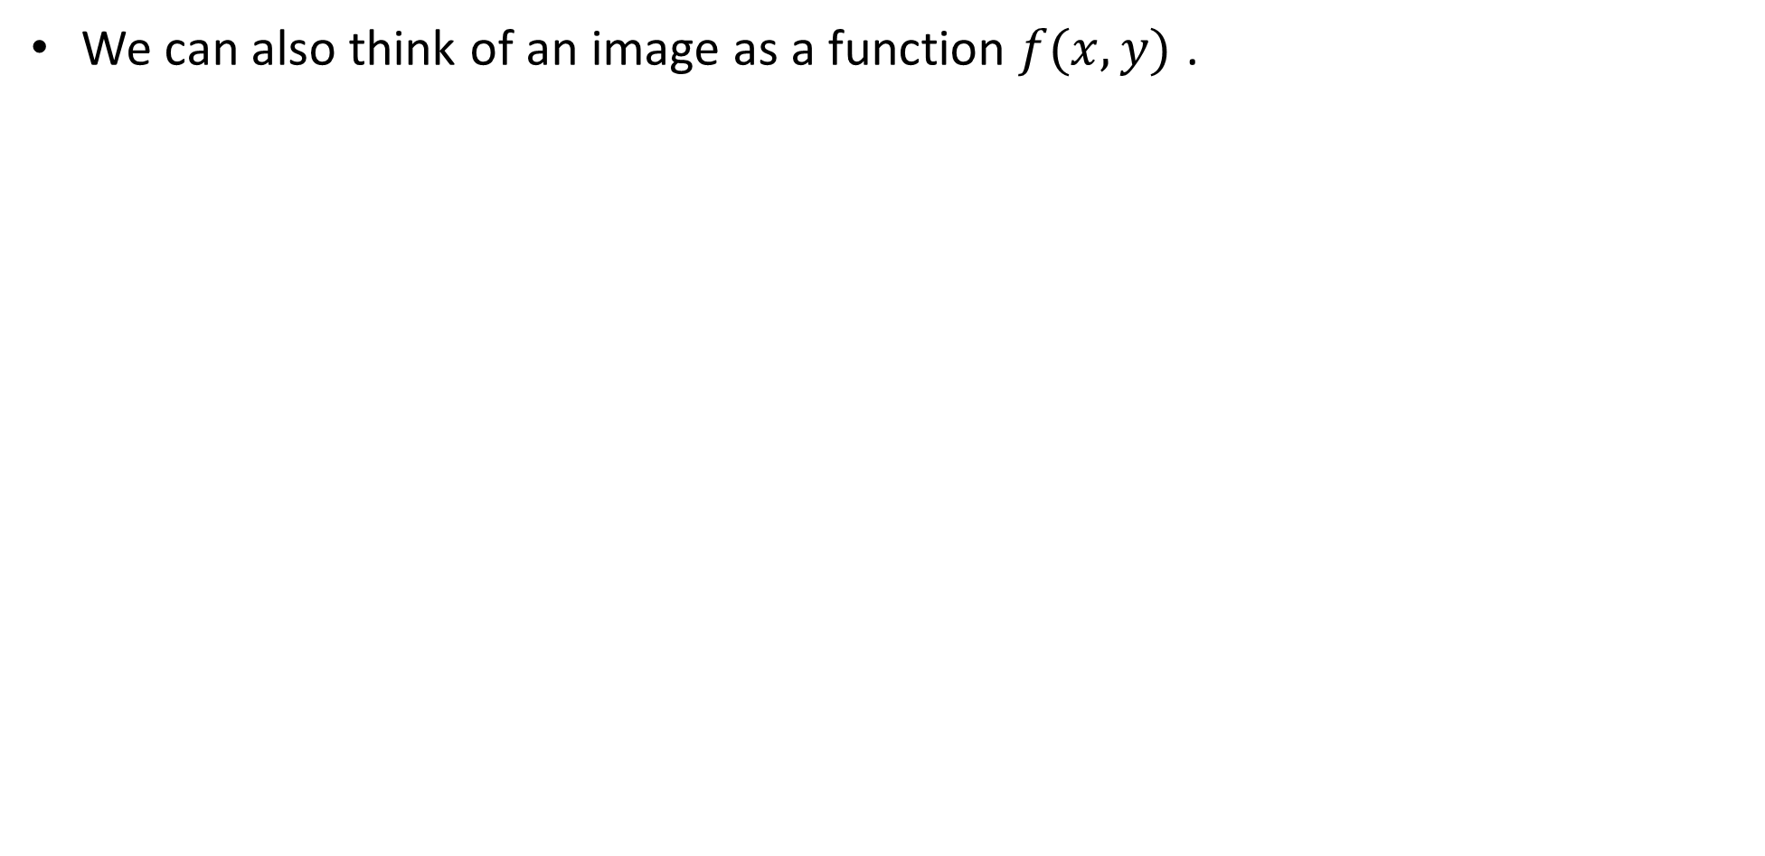
Image representation
We can also think of an image as a function $f(x,y)$ .

Slide 7
contents
Image representation
Pixel-wise operations
Noise and filtering
Frequency representation
Decimation
Interpolation
Morphology operators
Connected components

Slide 8
Pixel-wise operators
Pixel-wise operators, or point operators, are defined as such that each output pixel’s value depends on only the corresponding input pixel value.

Slide 9
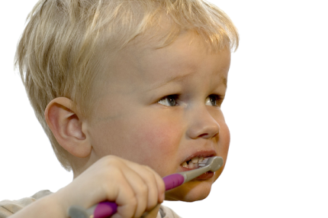
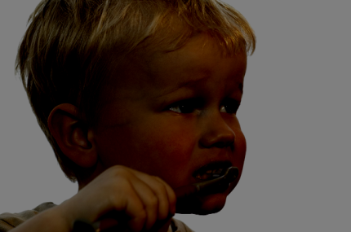
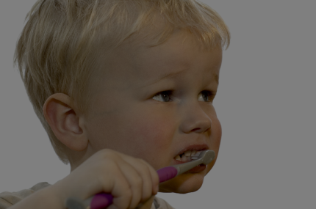
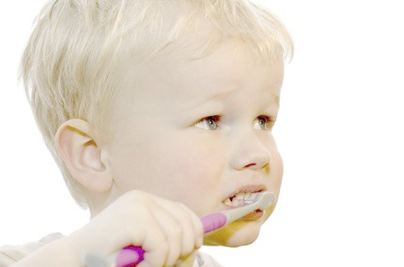
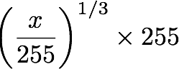
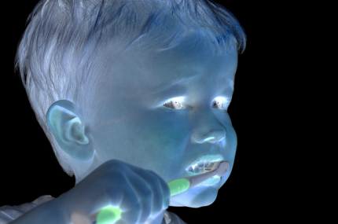
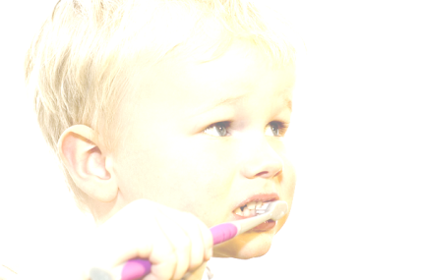

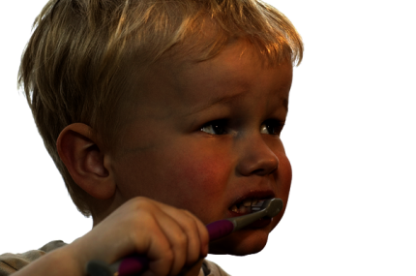
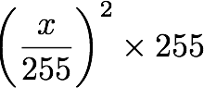
Pixel-wise operators
original
darken
lower contrast
Gamma compression
invert
lighten
raise contrast
Gamma expansion

Slide 10
Pixel-wise operators
original
darken
lower contrast
Gamma compression
invert
lighten
raise contrast
Gamma expansion

Slide 11
Pixel-wise operators
original
darken
lower contrast
Gamma compression
invert
lighten
raise contrast
Gamma expansion

Slide 12
Pixel-wise operators
original
darken
lower contrast
Gamma compression
invert
lighten
raise contrast
Gamma expansion

Slide 13
Pixel-wise operators
original
darken
lower contrast
Gamma compression
invert
lighten
raise contrast
Gamma expansion

Slide 14
Pixel-wise operators
original
darken
lower contrast
Gamma compression
invert
lighten
raise contrast
Gamma expansion

Slide 15
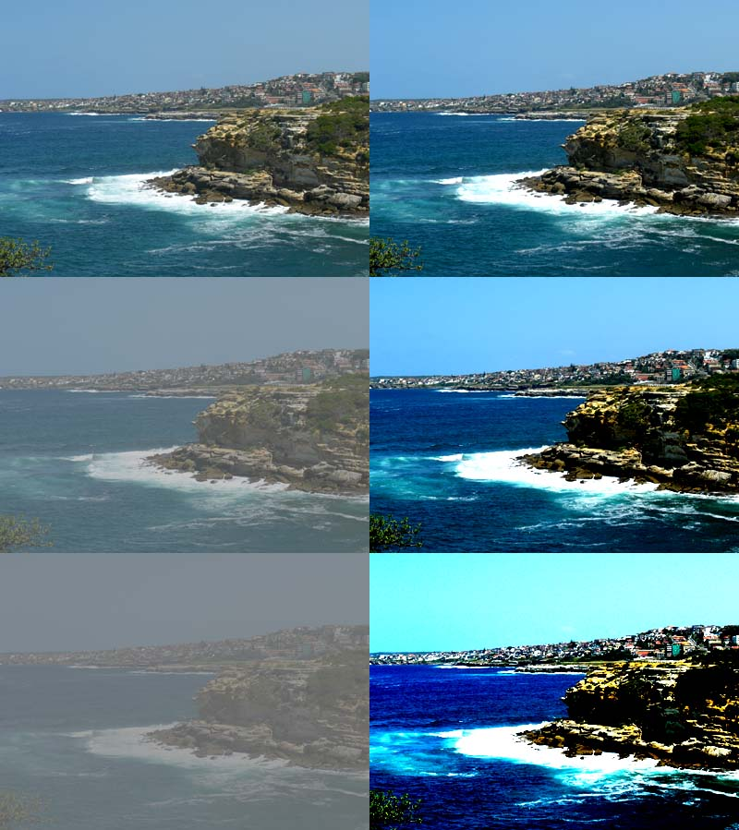
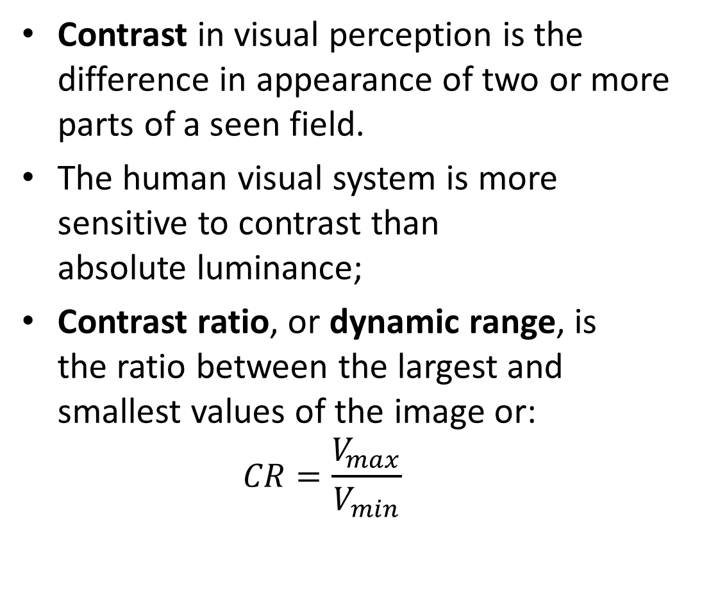
Contrast
Contrast in visual perception is the difference in appearance of two or more parts of a seen field.
The human visual system is more sensitive to contrast than absolute luminance;
Contrast ratio, or dynamic range, is the ratio between the largest and smallest values of the image or:
$$CR=\frac{V_{max}}{V_{min}}$$

Slide 16
Pixel-wise operators
original
darken
lower contrast
Gamma compression
invert
lighten
raise contrast
Gamma expansion

Slide 17
Pixel-wise operators
original
darken
lower contrast
Gamma compression
invert
lighten
raise contrast
Gamma expansion

Slide 18
Pixel-wise operators
original
darken
lower contrast
Gamma compression
invert
lighten
raise contrast
Gamma expansion

Slide 19
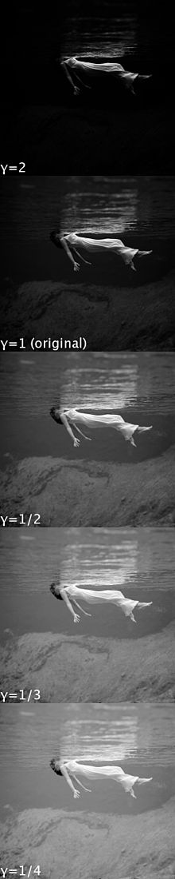
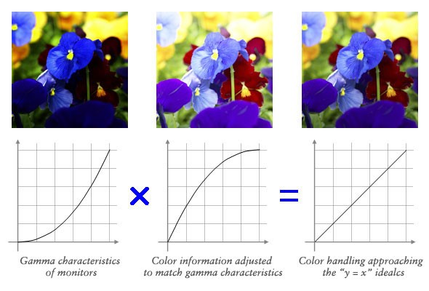
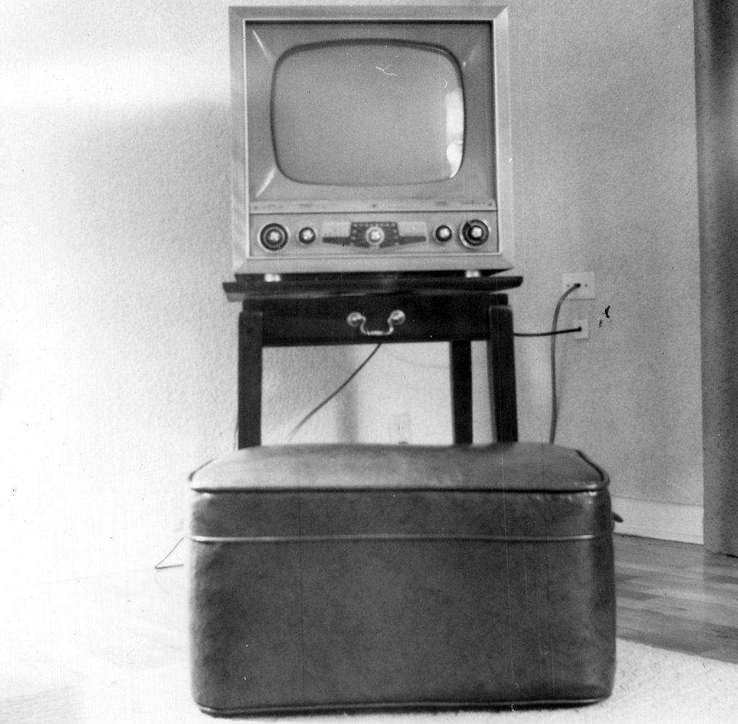
Gamma correction
Originally, Due to non-linearities in the old CRT televisions, intensities was seen different then they are.

Slide 20
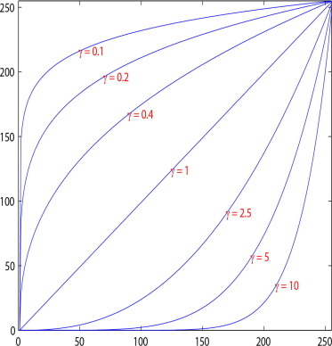
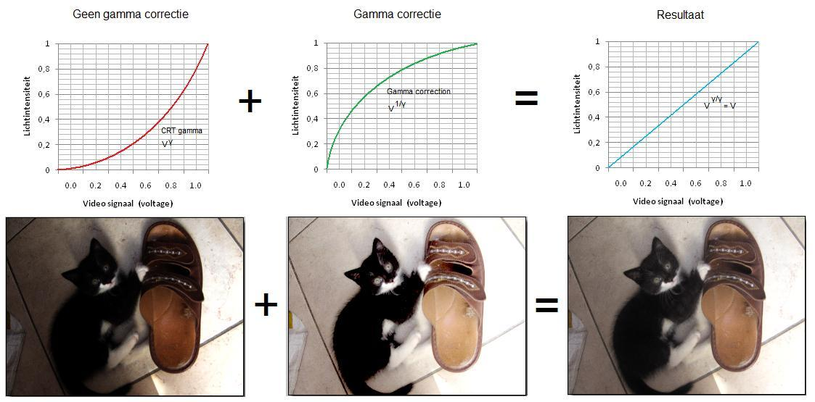
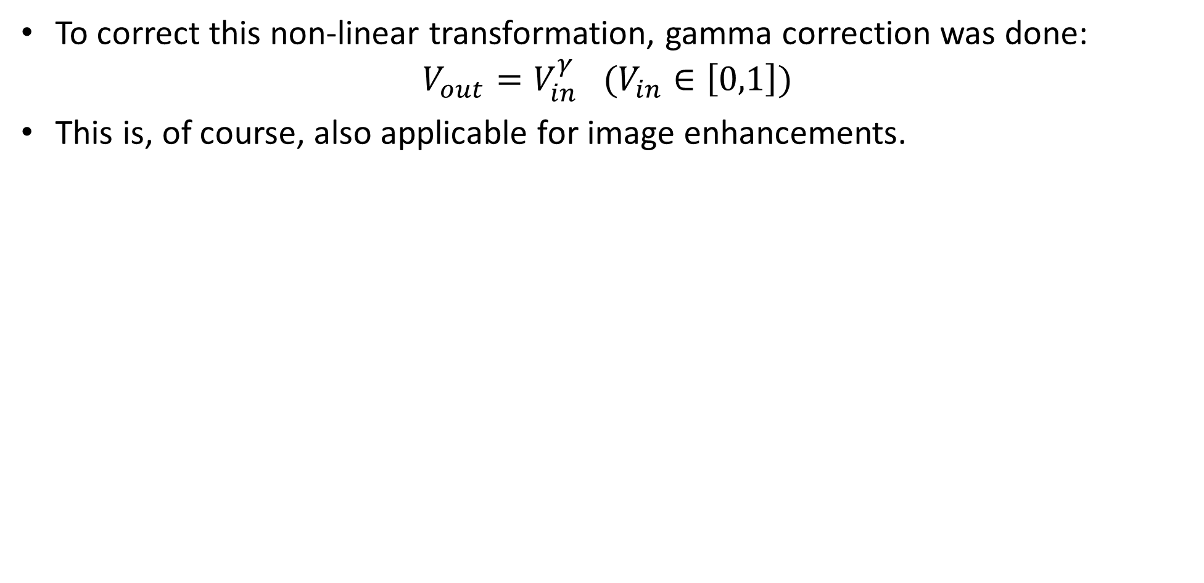
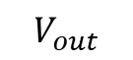
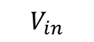
Gamma correction
To correct this non-linear transformation, gamma correction was done:
$$V_{out}=V_{in}^{γ} (V_{in}∈\left[0,1\right])$$
This is, of course, also applicable for image enhancements.
$$V_{out}$$
$$V_{in}$$

Slide 21
Histogram equalization

Slide 22
contents
Image representation
Pixel-wise operations
Noise and filtering
Frequency representation
Decimation
Interpolation
Morphology operators
Connected components

Slide 23
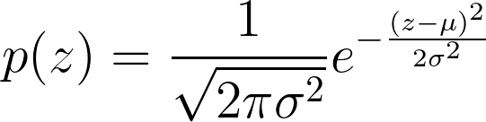
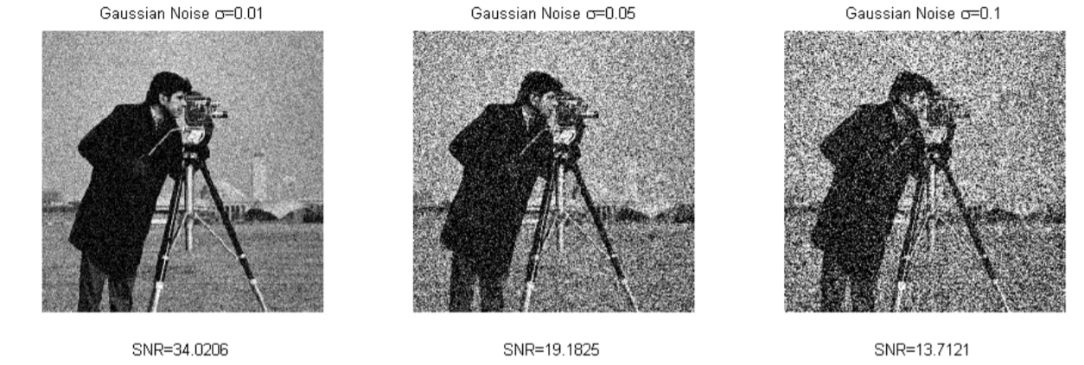
Gaussian Noise
Gaussian noise is an additive noise that can appear in images due to the system electrical circuitry.
This noise is independent of signal strength and independent at each pixel (IID- independent and identically distributed).

Slide 24
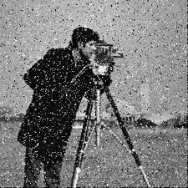
Salt & Pepper noise
Noise that can be caused by analog-to-digital converter errors, bit errors in transmission, etc.
This noise is not additive to the signal strength (a replacement of original value with noise value).
This noise is independent of signal strength and independent at each pixel.

Slide 25
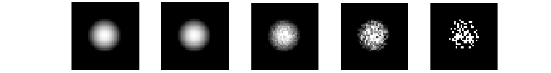
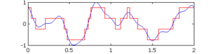
And some more noise
Shot noise - caused by statistical quantum fluctuations, that is, variation in the number of photons sensed at a given exposure level in the darker parts of an image (where there are just few photons that enter each pixel “bin”). Modeled as Poisson noise.
Quantization noise – caused by quantizing the pixels of a sensed image to several discrete levels (analog to digital conversion).

Slide 26
Noise reduction with LTI filters
LTI (LSI) filters are also known as convolution filters or kernel filters and are a known solution for the noise problem.
They are linear operators, which involve weighted combinations of pixels in small neighborhood, The combination is determined by the filter’s kernel.
The same kernel is shifted to all pixel locations so that all pixels use the same linear combination of their neighbors.
Shifting the output after the weighted combination vs. shifting the input and then doing weighted combination is the same- so shift-invariance.
That’s why it’s called linear shift-invariance filter.
LSI for short, but more commonly known by the name of the 1D signal filter- LTI, linear time-invariant.

Slide 27
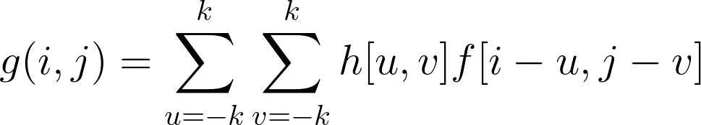
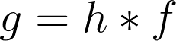
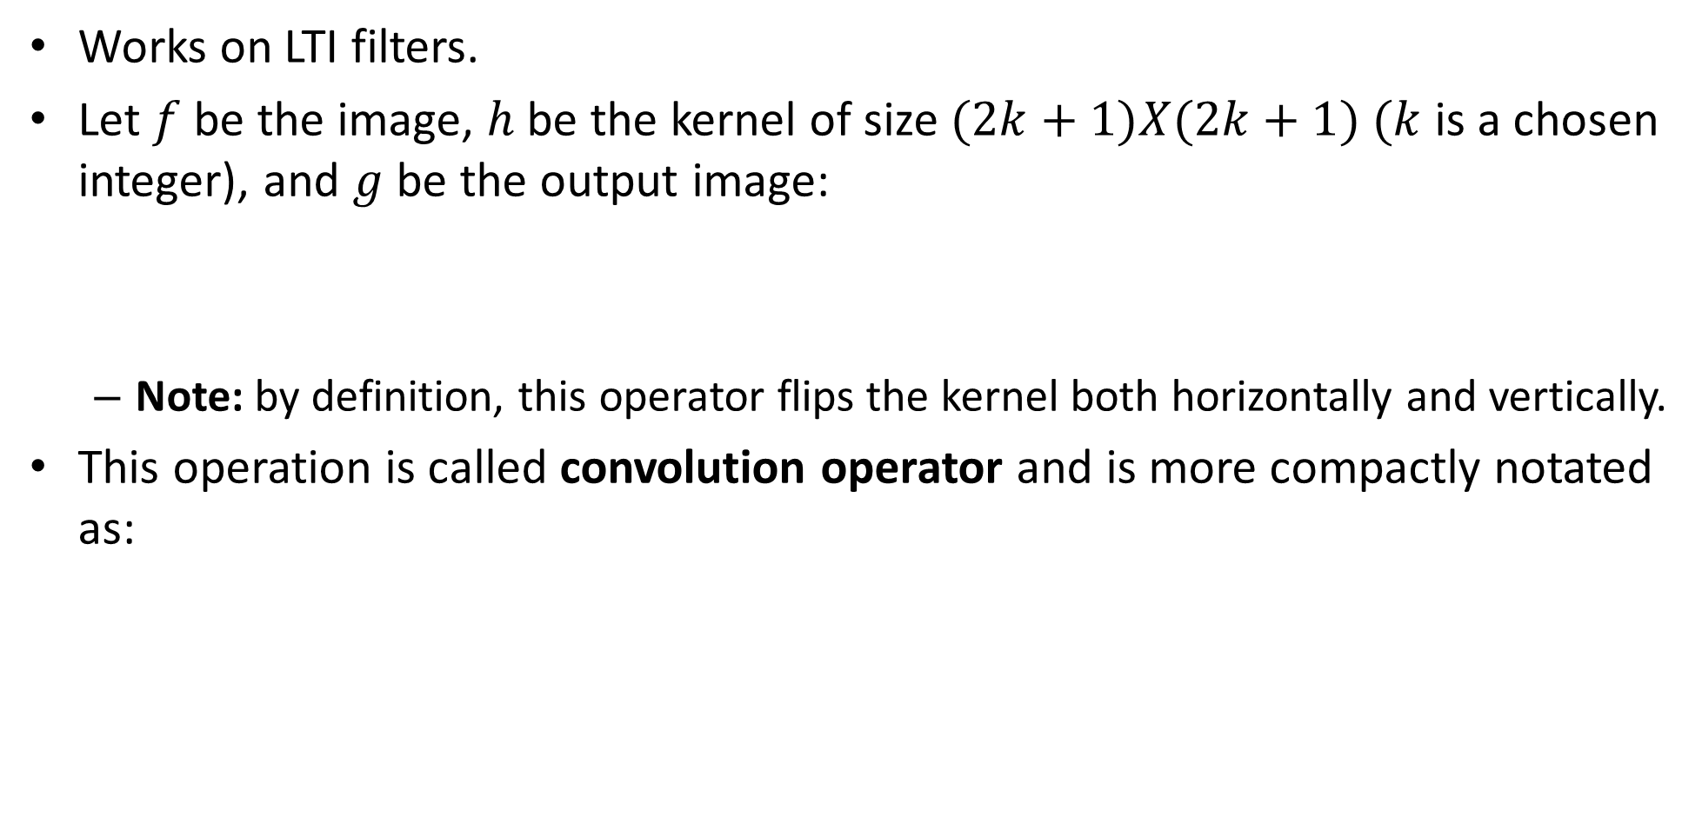
Convolution
Works on LTI filters.
Let $f$be the image, $h$ be the kernel of size $(2k+1)X(2k+1)$ $(k$ is a chosen integer), and $g$ be the output image:
Note: by definition, this operator flips the kernel both horizontally and vertically.
This operation is called convolution operator and is more compactly notated as:

Slide 28
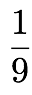
Example: mean filter
The kernel is:
Replaces pixel with local average.
Has smoothing (blurring) effect.
The kernel can be in any other size as well (see .ipynb).
1 | 1 | 1
1 | 1 | 1
1 | 1 | 1

Slide 29
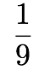
Run the filter
image
output
0 | 0 | 0 | 0 | 0 | 0 | 0 | 0 | 0 | 0
0 | 0 | 0 | 0 | 0 | 0 | 0 | 0 | 0 | 0
0 | 0 | 0 | 90 | 90 | 90 | 90 | 90 | 0 | 0
0 | 0 | 0 | 90 | 90 | 90 | 90 | 90 | 0 | 0
0 | 0 | 0 | 90 | 0 | 90 | 90 | 90 | 0 | 0
0 | 0 | 0 | 90 | 90 | 90 | 90 | 90 | 0 | 0
0 | 0 | 0 | 0 | 0 | 0 | 0 | 0 | 0 | 0
0 | 0 | 0 | 0 | 0 | 0 | 0 | 0 | 0 | 0
0 | 0 | 90 | 0 | 0 | 0 | 0 | 0 | 0 | 0
0 | 0 | 0 | 0 | 0 | 0 | 0 | 0 | 0 | 0
kernel
1 | 1 | 1
1 | 1 | 1
1 | 1 | 1
Note that we assume that the kernel coordinates are centered.
Here the kernel is symmetric horizontally and vertically, so the flipping is not noticeable.

Slide 30
Run the filter
image
output
0 | 0 | 0 | 0 | 0 | 0 | 0 | 0 | 0 | 0
0 | 0 | 0 | 0 | 0 | 0 | 0 | 0 | 0 | 0
0 | 0 | 0 | 90 | 90 | 90 | 90 | 90 | 0 | 0
0 | 0 | 0 | 90 | 90 | 90 | 90 | 90 | 0 | 0
0 | 0 | 0 | 90 | 0 | 90 | 90 | 90 | 0 | 0
0 | 0 | 0 | 90 | 90 | 90 | 90 | 90 | 0 | 0
0 | 0 | 0 | 0 | 0 | 0 | 0 | 0 | 0 | 0
0 | 0 | 0 | 0 | 0 | 0 | 0 | 0 | 0 | 0
0 | 0 | 90 | 0 | 0 | 0 | 0 | 0 | 0 | 0
0 | 0 | 0 | 0 | 0 | 0 | 0 | 0 | 0 | 0
 | 0
kernel
1 | 1 | 1
1 | 1 | 1
1 | 1 | 1

Slide 31
Run the filter
image
output
0 | 0 | 0 | 0 | 0 | 0 | 0 | 0 | 0 | 0
0 | 0 | 0 | 0 | 0 | 0 | 0 | 0 | 0 | 0
0 | 0 | 0 | 90 | 90 | 90 | 90 | 90 | 0 | 0
0 | 0 | 0 | 90 | 90 | 90 | 90 | 90 | 0 | 0
0 | 0 | 0 | 90 | 0 | 90 | 90 | 90 | 0 | 0
0 | 0 | 0 | 90 | 90 | 90 | 90 | 90 | 0 | 0
0 | 0 | 0 | 0 | 0 | 0 | 0 | 0 | 0 | 0
0 | 0 | 0 | 0 | 0 | 0 | 0 | 0 | 0 | 0
0 | 0 | 90 | 0 | 0 | 0 | 0 | 0 | 0 | 0
0 | 0 | 0 | 0 | 0 | 0 | 0 | 0 | 0 | 0
 | 0
kernel
1 | 1 | 1
1 | 1 | 1
1 | 1 | 1
shift

Slide 32
Run the filter
image
output
0 | 0 | 0 | 0 | 0 | 0 | 0 | 0 | 0 | 0
0 | 0 | 0 | 0 | 0 | 0 | 0 | 0 | 0 | 0
0 | 0 | 0 | 90 | 90 | 90 | 90 | 90 | 0 | 0
0 | 0 | 0 | 90 | 90 | 90 | 90 | 90 | 0 | 0
0 | 0 | 0 | 90 | 0 | 90 | 90 | 90 | 0 | 0
0 | 0 | 0 | 90 | 90 | 90 | 90 | 90 | 0 | 0
0 | 0 | 0 | 0 | 0 | 0 | 0 | 0 | 0 | 0
0 | 0 | 0 | 0 | 0 | 0 | 0 | 0 | 0 | 0
0 | 0 | 90 | 0 | 0 | 0 | 0 | 0 | 0 | 0
0 | 0 | 0 | 0 | 0 | 0 | 0 | 0 | 0 | 0
 | 0 | 10
kernel
1 | 1 | 1
1 | 1 | 1
1 | 1 | 1

Slide 33
Run the filter
image
output
0 | 0 | 0 | 0 | 0 | 0 | 0 | 0 | 0 | 0
0 | 0 | 0 | 0 | 0 | 0 | 0 | 0 | 0 | 0
0 | 0 | 0 | 90 | 90 | 90 | 90 | 90 | 0 | 0
0 | 0 | 0 | 90 | 90 | 90 | 90 | 90 | 0 | 0
0 | 0 | 0 | 90 | 0 | 90 | 90 | 90 | 0 | 0
0 | 0 | 0 | 90 | 90 | 90 | 90 | 90 | 0 | 0
0 | 0 | 0 | 0 | 0 | 0 | 0 | 0 | 0 | 0
0 | 0 | 0 | 0 | 0 | 0 | 0 | 0 | 0 | 0
0 | 0 | 90 | 0 | 0 | 0 | 0 | 0 | 0 | 0
0 | 0 | 0 | 0 | 0 | 0 | 0 | 0 | 0 | 0
 | 0 | 10 | 20
kernel
1 | 1 | 1
1 | 1 | 1
1 | 1 | 1

Slide 34
Run the filter
image
output
0 | 0 | 0 | 0 | 0 | 0 | 0 | 0 | 0 | 0
0 | 0 | 0 | 0 | 0 | 0 | 0 | 0 | 0 | 0
0 | 0 | 0 | 90 | 90 | 90 | 90 | 90 | 0 | 0
0 | 0 | 0 | 90 | 90 | 90 | 90 | 90 | 0 | 0
0 | 0 | 0 | 90 | 0 | 90 | 90 | 90 | 0 | 0
0 | 0 | 0 | 90 | 90 | 90 | 90 | 90 | 0 | 0
0 | 0 | 0 | 0 | 0 | 0 | 0 | 0 | 0 | 0
0 | 0 | 0 | 0 | 0 | 0 | 0 | 0 | 0 | 0
0 | 0 | 90 | 0 | 0 | 0 | 0 | 0 | 0 | 0
0 | 0 | 0 | 0 | 0 | 0 | 0 | 0 | 0 | 0
 | 0 | 10 | 20 | 30
kernel
1 | 1 | 1
1 | 1 | 1
1 | 1 | 1

Slide 35
Run the filter
image
output
0 | 0 | 0 | 0 | 0 | 0 | 0 | 0 | 0 | 0
0 | 0 | 0 | 0 | 0 | 0 | 0 | 0 | 0 | 0
0 | 0 | 0 | 90 | 90 | 90 | 90 | 90 | 0 | 0
0 | 0 | 0 | 90 | 90 | 90 | 90 | 90 | 0 | 0
0 | 0 | 0 | 90 | 0 | 90 | 90 | 90 | 0 | 0
0 | 0 | 0 | 90 | 90 | 90 | 90 | 90 | 0 | 0
0 | 0 | 0 | 0 | 0 | 0 | 0 | 0 | 0 | 0
0 | 0 | 0 | 0 | 0 | 0 | 0 | 0 | 0 | 0
0 | 0 | 90 | 0 | 0 | 0 | 0 | 0 | 0 | 0
0 | 0 | 0 | 0 | 0 | 0 | 0 | 0 | 0 | 0
 | 0 | 10 | 20 | 30 | 30
kernel
1 | 1 | 1
1 | 1 | 1
1 | 1 | 1

Slide 36
Run the filter
image
output
0 | 0 | 0 | 0 | 0 | 0 | 0 | 0 | 0 | 0
0 | 0 | 0 | 0 | 0 | 0 | 0 | 0 | 0 | 0
0 | 0 | 0 | 90 | 90 | 90 | 90 | 90 | 0 | 0
0 | 0 | 0 | 90 | 90 | 90 | 90 | 90 | 0 | 0
0 | 0 | 0 | 90 | 0 | 90 | 90 | 90 | 0 | 0
0 | 0 | 0 | 90 | 90 | 90 | 90 | 90 | 0 | 0
0 | 0 | 0 | 0 | 0 | 0 | 0 | 0 | 0 | 0
0 | 0 | 0 | 0 | 0 | 0 | 0 | 0 | 0 | 0
0 | 0 | 90 | 0 | 0 | 0 | 0 | 0 | 0 | 0
0 | 0 | 0 | 0 | 0 | 0 | 0 | 0 | 0 | 0
 | 0 | 10 | 20 | 30 | 30 | 30
kernel
1 | 1 | 1
1 | 1 | 1
1 | 1 | 1

Slide 37
… and the result is
image
output
0 | 0 | 0 | 0 | 0 | 0 | 0 | 0 | 0 | 0
0 | 0 | 0 | 0 | 0 | 0 | 0 | 0 | 0 | 0
0 | 0 | 0 | 90 | 90 | 90 | 90 | 90 | 0 | 0
0 | 0 | 0 | 90 | 90 | 90 | 90 | 90 | 0 | 0
0 | 0 | 0 | 90 | 0 | 90 | 90 | 90 | 0 | 0
0 | 0 | 0 | 90 | 90 | 90 | 90 | 90 | 0 | 0
0 | 0 | 0 | 0 | 0 | 0 | 0 | 0 | 0 | 0
0 | 0 | 0 | 0 | 0 | 0 | 0 | 0 | 0 | 0
0 | 0 | 90 | 0 | 0 | 0 | 0 | 0 | 0 | 0
0 | 0 | 0 | 0 | 0 | 0 | 0 | 0 | 0 | 0
 | 0 | 10 | 20 | 30 | 30 | 30 | 20 | 10
 | 0 | 20 | 40 | 60 | 60 | 60 | 40 | 20
 | 0 | 30 | 50 | 80 | 80 | 90 | 60 | 30
 | 0 | 30 | 50 | 80 | 80 | 90 | 60 | 30
 | 0 | 20 | 30 | 50 | 50 | 60 | 40 | 20
 | 0 | 10 | 20 | 30 | 30 | 30 | 20 | 10
 | 10 | 10 | 10 | 10 | 0 | 0 | 0 | 0
 | 10 | 10 | 10 | 10 | 0 | 0 | 0 | 0
kernel
1 | 1 | 1
1 | 1 | 1
1 | 1 | 1

Slide 38
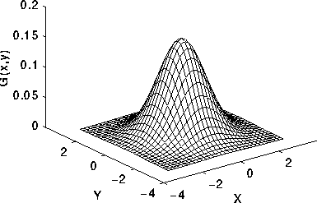
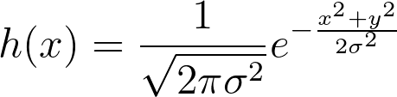
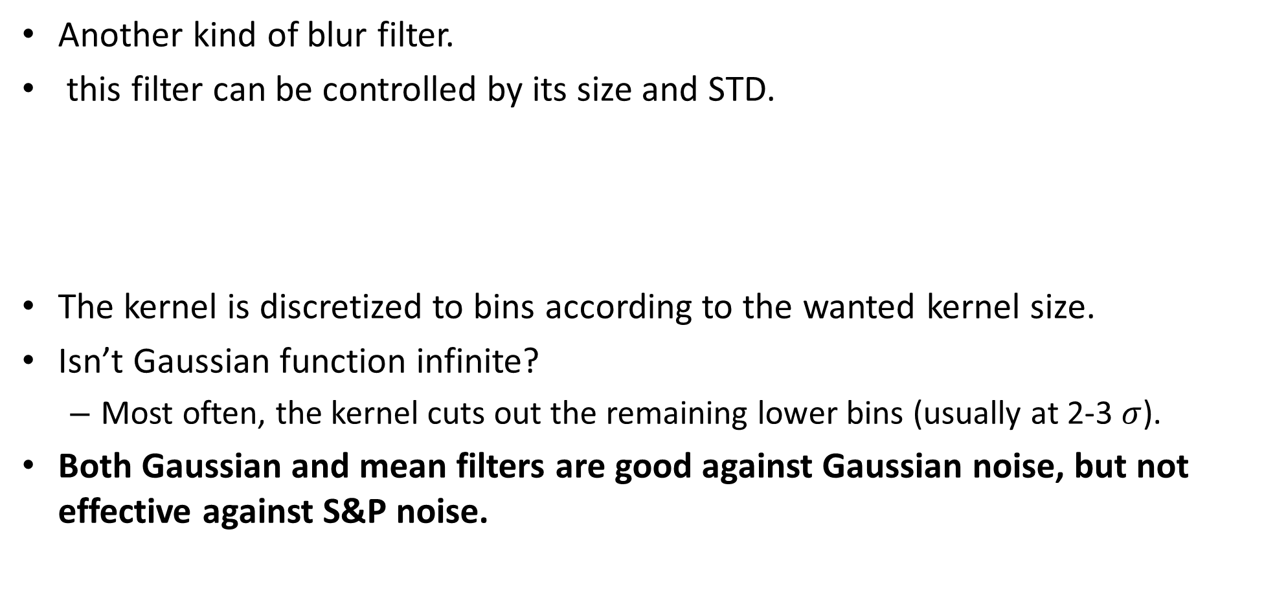
Gaussian filter
Another kind of blur filter.
this filter can be controlled by its size and STD.
The kernel is discretized to bins according to the wanted kernel size.
Isn’t Gaussian function infinite?
Most often, the kernel cuts out the remaining lower bins (usually at 2-3 $σ$).
Both Gaussian and mean filters are good against Gaussian noise, but not effective against S&P noise.
Notes:
h(x) = \frac{1}{\sqrt{2\pi \sigma^2}} e^{-\frac{x^2+y^2}{2 \sigma^2}}

Slide 39
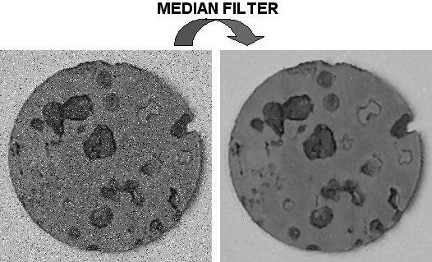
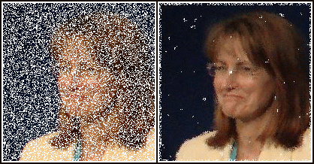
Median filter
Takes the median value from the given neighbors.
For example:
The median of [1, 0, 100] is 1.
Median filter is good against salt and pepper noise & against Gaussian noise (but not as effective).
Can be considered as a blur filter, but also has edge preserving properties.
Median filter is more computationally expansive than mean/gaussian.
This filter is not LTI because it’s not linear on its weights.
Notes:
if LxL size of kernel and MxN image size:
- Mean/ gaussian are separable- O(LMN) https://dsp.stackexchange.com/questions/36962/why-does-the-separable-filter-reduce-the-cost-of-computing-the-operator/36964
- median: O((L^2)MN)

Slide 40
Example in .ipynb

Slide 41
contents
Image representation
Pixel-wise operations
Noise and filtering
Frequency representation
Decimation
Interpolation
Morphology operators
Connected components

Slide 42
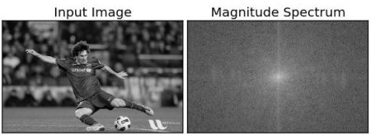
FFT of an image
Frequency analysis is not in the scope of the course and is not needed for the rest of the course, but here it can give some intuition.
In audio signals (or any other 1D signals) Lower frequencies change less over time than higher frequencies.
In images, the change is represented in change in distance, so images that changes slowly from pixel to pixel has more lower frequencies then others.
Natural images are mainly built from low frequencies.
Low freqs
High freqs

Slide 43
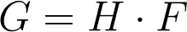
Convolution in frequency domain
Recall: in time (space) domain:
In frequency domain- simple multiplication:
Notes:
G=H \cdot F

Slide 44
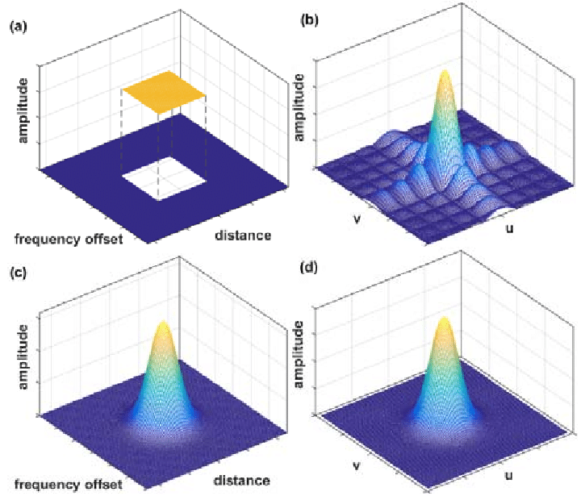
Low-pass filters
Both mean and Gaussian filters are considered low-pass filters because in the frequency domain, they have higher values in the lower frequencies- and when multiplied with frequency spectrums, the high frequencies get smaller.
When image is left only with the lower frequencies, the rapidly changes parts of the image (e.g.: edges, noise) are smoothen.

Slide 45
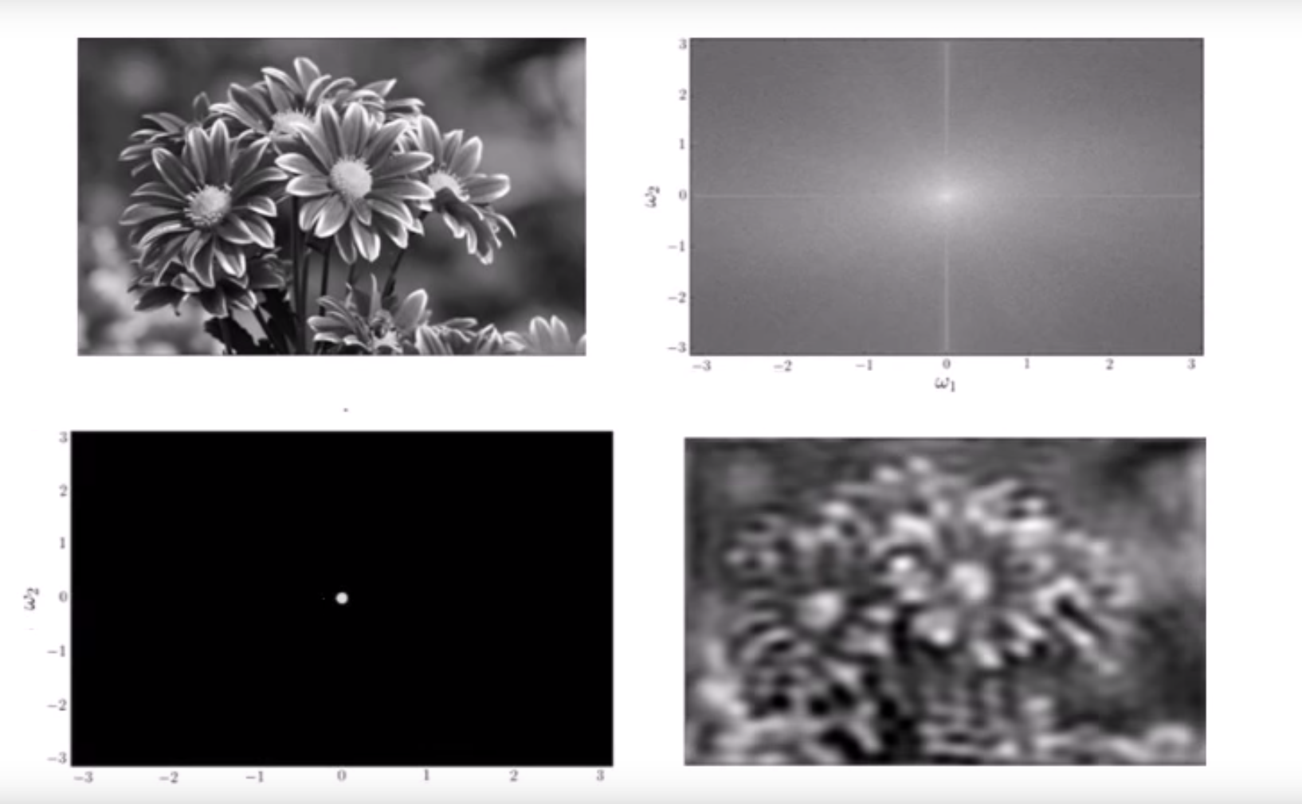
LP example

Slide 46
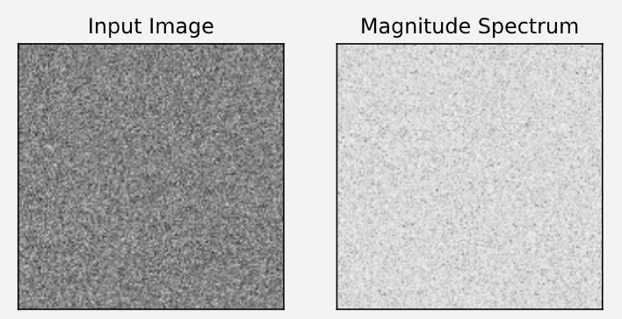
FFT of gaussian noise
Since gaussian noise (AWGN) is distributed along all frequencies, LP filter reduce this kind of noise significantly.

Slide 47
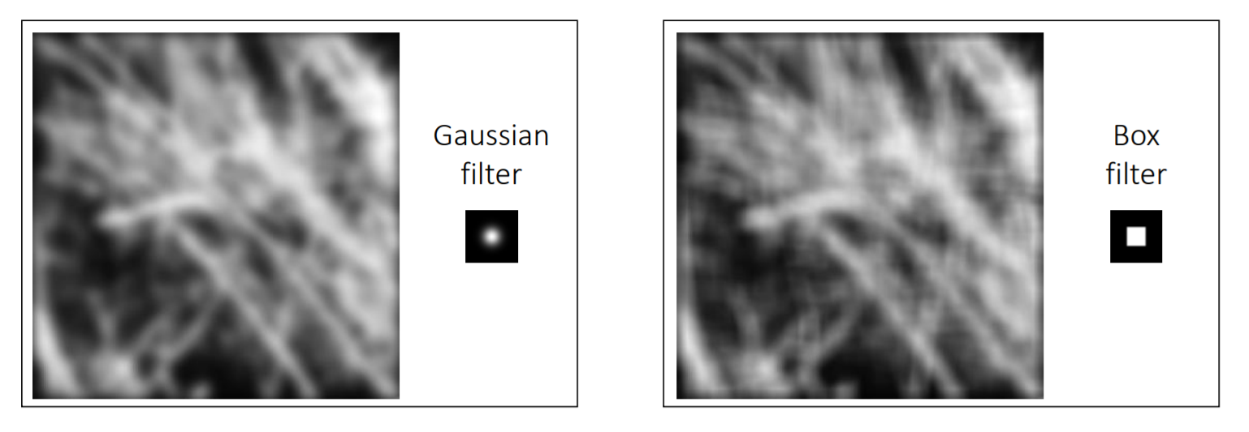
Mean vs. Gaussian filter
Since Mean filter has higher values in the higher frequencies, edge artifacts sometimes remains.

Slide 48
contents
Image representation
Pixel-wise operations
Noise and filtering
Frequency representation
Decimation
Interpolation
Morphology operators
Connected components

Slide 49

Image Scaling
This image is too big to fit on the screen. How can we generate a half-sized version?
Source: S. Seitz

Slide 50



Image sub-sampling
1/8
1/4
Throw away every other row and column to create a 1/2 size image
- called image sub-sampling or decimation
Source: S. Seitz

Slide 51
Image sub-sampling
1/2
1/4 (2x zoom)
1/8 (4x zoom)
Source: S. Seitz

Slide 52

Image sub-sampling
Source: F. Durand

Slide 53

Even worse for synthetic images
Source: L. Zhang

Slide 54

Aliasing
Occurs when your sampling rate is not high enough to capture the amount of detail in your image
Can give you the wrong signal/image—an alias
To do sampling right, need to understand the structure of your signal/image
To avoid aliasing:
sampling rate ≥ 2 * max frequency in the image
This minimum sampling rate is called the Nyquist rate
Source: L. Zhang

Slide 55

Nyquist limit – 2D example
Good sampling
Bad sampling

Slide 56

Nyquist limit- frequency response
Original freq representation of signal.
Regular sampling above nyquist rate- can recreate the original frequencies of the image. (copies are from sampling).
Sampling below nyquist- original frequencies are destroyed due to the copies overlap- this is the aliasing.

Slide 57

Example: wagon-wheel effect
An example of sub sampling in time domain (instead of spatially like before).
https://en.wikipedia.org/wiki/Wagon-wheel_effect

Slide 58



Gaussian pre-filtering
G 1/8
G 1/4
Gaussian 1/2
Solution: filter the image, then subsample
Source: S. Seitz

Slide 59
Subsampling with Gaussian pre-filtering
Gaussian 1/2
G 1/4
G 1/8
Solution: filter the image, then subsample
Source: S. Seitz

Slide 60
Compare with...
1/2
1/4 (2x zoom)
1/8 (4x zoom)
Source: S. Seitz

Slide 61

Low pass filtering- frequency response

Slide 62


Back to the checkerboard
What should happen when you make the checkerboard smaller and smaller?
Image turns grey! (Average of black and white squares, because each pixel contains both.)
Naïve subsampling
Proper prefiltering
(“antialiasing”)

Slide 63








Gaussian pre-filtering
Solution: filter the image, then subsample
F₀
F₁
F₂
…
blur
subsample
blur
subsample
F₀ H
F₁ H
*
*

Slide 64
{
Gaussian pyramid
F₀
F₁
F₂
…
blur
subsample
blur
subsample
F₀ H
F₁ H
*
*

Slide 65


Slide 66

Gaussian Pyramid

Slide 67
contents
Image representation
Pixel-wise operations
Noise and filtering
Frequency representation
Decimation
Interpolation
Morphology operators
Connected components

Slide 68

Upsampling
This image is too small for this screen:
How can we make it 10 times as big?
Simplest approach: repeat each row and column 10 times (“Nearest neighbor interpolation”)
This operation is known as upsampling or interpolation.

Slide 69

Upsampling

Slide 70


Image interpolation
Original image: x 10
Nearest-neighbor interpolation
Bilinear interpolation
Bicubic interpolation

Slide 71


Image interpolation
Also used for image warping

Slide 72
contents
Image representation
Pixel-wise operations
Noise and filtering
Frequency representation
Decimation
Interpolation
Morphology operators
Connected components

Slide 73




Morphology
Handy tool whenever needed to clean up binary images.
Each morphology operator is constructed as such:
Select some kind of structure element (binary kernel)
Convolve with input binary image
Threshold the output
Overall morphologic operation should look like so:
Notes:
\theta_{TH}(x,t) = \left\{\begin{matrix}
1 & if & x\geq t,\\
0 & else
\end{matrix}
g = f*s
s = \begin{bmatrix}
0 & 0 & 1 & 0 & 0\\
0 & 1 & 1 & 1 & 0\\
1 & 1 & 1 & 1 & 1\\
0 & 1 & 1 & 1 & 0\\
0 & 0 & 1 & 0 & 0
\end{bmatrix}
k = \theta_{TH}(f*s,t)

Slide 74
Morphology
Handy tool whenever needed to clean up binary images.
Each morphology operator is constructed as such:
Select some kind of structure element (binary kernel)
Convolve with input binary image
Threshold the output
Overall morphologic operation should look like so:
Notes:
\theta_{TH}(x,t) = \left\{\begin{matrix}
1 & if & x\geq t,\\
0 & else
\end{matrix}
g = f*s
s = \begin{bmatrix}
0 & 0 & 1 & 0 & 0\\
0 & 1 & 1 & 1 & 0\\
1 & 1 & 1 & 1 & 1\\
0 & 1 & 1 & 1 & 0\\
0 & 0 & 1 & 0 & 0
\end{bmatrix}
k = \theta_{TH}(f*s,t)

Slide 75
Morphology
Handy tool whenever needed to clean up binary images.
Each morphology operator is constructed as such:
Select some kind of structure element (binary kernel)
Convolve with input binary image
Threshold the output
Overall morphologic operation should look like so:
Notes:
\theta_{TH}(x,t) = \left\{\begin{matrix}
1 & if & x\geq t,\\
0 & else
\end{matrix}
g = f*s
s = \begin{bmatrix}
0 & 0 & 1 & 0 & 0\\
0 & 1 & 1 & 1 & 0\\
1 & 1 & 1 & 1 & 1\\
0 & 1 & 1 & 1 & 0\\
0 & 0 & 1 & 0 & 0
\end{bmatrix}
k = \theta_{TH}(f*s,t)

Slide 76
Morphology
Handy tool whenever needed to clean up binary images.
Each morphology operator is constructed as such:
Select some kind of structure element (binary kernel)
Convolve with input binary image
Threshold the output
Overall morphologic operation should look like so:
Notes:
\theta_{TH}(x,t) = \left\{\begin{matrix}
1 & if & x\geq t,\\
0 & else
\end{matrix}
g = f*s
s = \begin{bmatrix}
0 & 0 & 1 & 0 & 0\\
0 & 1 & 1 & 1 & 0\\
1 & 1 & 1 & 1 & 1\\
0 & 1 & 1 & 1 & 0\\
0 & 0 & 1 & 0 & 0
\end{bmatrix}
k = \theta_{TH}(f*s,t)

Slide 77


Dilation
Select some kind of structure element (binary kernel)
Convolve with input binary image
Threshold the output
Dilation: $t=1$
Skinny lines will get thicker
Notes:
\theta_{TH}(x,t) = \left\{\begin{matrix}
1 & if & x\geq t,\\
0 & else
\end{matrix}
g = f*s
s = \begin{bmatrix}
0 & 0 & 1 & 0 & 0\\
0 & 1 & 1 & 1 & 0\\
1 & 1 & 1 & 1 & 1\\
0 & 1 & 1 & 1 & 0\\
0 & 0 & 1 & 0 & 0
\end{bmatrix}

Slide 78


Erosion
Select some kind of structure element (binary kernel)
Convolve with input binary image
Threshold the output
Erosion: $t=sum(s)$
Thicker lines will get skinny
Notes:
\theta_{TH}(x,t) = \left\{\begin{matrix}
1 & if & x\geq t,\\
0 & else
\end{matrix}
g = f*s
s = \begin{bmatrix}
0 & 0 & 1 & 0 & 0\\
0 & 1 & 1 & 1 & 0\\
1 & 1 & 1 & 1 & 1\\
0 & 1 & 1 & 1 & 0\\
0 & 0 & 1 & 0 & 0
\end{bmatrix}

Slide 79


Opening
Erosion followed by dilation.
The effect is of rounding off sharp edges.

Slide 80
Closing
Dilation followed by erosion.
The effect is of closing of narrow gaps and holes.

Slide 81
contents
Image representation
Pixel-wise operations
Noise and filtering
Frequency representation
Decimation
Interpolation
Morphology operators
Connected components

Slide 82

Connected components
Defined as regions of adjacent pixels that have the same value.
Commonly used with binary images to find stand alone objects.
e.g.: letters in a document.

